Slide 1
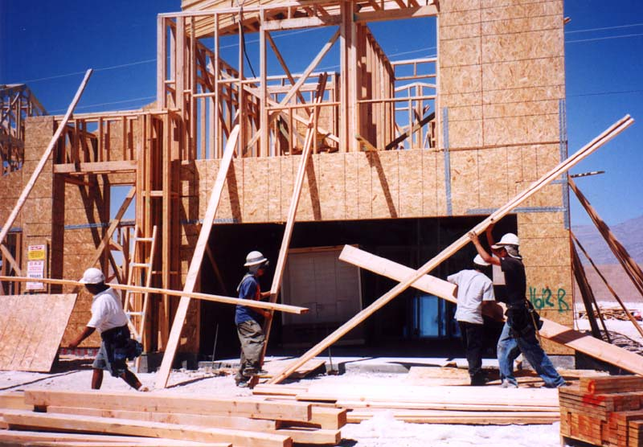
Making Houses More Appealing to Buyers
Problem statement, dataset and initial findings
RAFAEL MOREIRA SILVEIRA
SPRINGBOARD – DATA SCIENCE CAREER TRACK

Slide 2
Problem statement
Considering the Housing market, which home improvement services results in high increases in the selling price?
The goal of this project is to identify which “affectable variables” have the most positive impact on the selling price.

Slide 3
dataset
The dataset used for this study is the Ames Housing Dataset, which presents 79 explanatory variables describing several aspects of residential homes in Ames, Iowa, United States.
https://www.kaggle.com/c/house-prices-advanced-regression-techniques/overview
Once this study is finalized, with minor adjustments, the algorithms generated may be applied for different regions.
To treat this dataset, the following operations were necessary:
Checked for errors – mistyped information, for example
Cleaned or filled missing information
Checked for consistency among columns
Treated outliers
All those steps are detailed in the Data Wrangling Report.

Slide 4
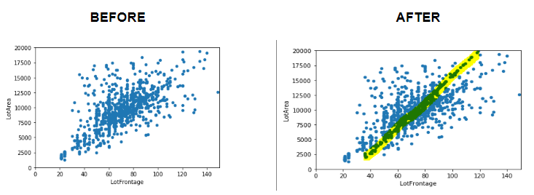
Initial findings - LotFrontage and LotArea
Association between variables LotFrontage and LotArea
We verified that this relationship exists and used it to fill missing values

Slide 5
Initial findings - not so useful variables
Roof Style and Roof Material
Roof styles are predominantly "Gable" with material "standard Shingle". As we have very few observations of the other types of Roof and types of material, we cannot draw statistically relevant conclusions. As a result, this variable will not be among those we will suggest to be improved.
Pool Quality
Not enough houses with pool to draw significant conclusions. Improving the quality of the pool will not be suggested to owners.

Slide 6
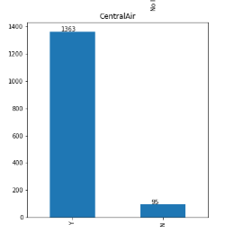
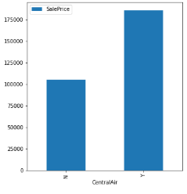
Initial findings – Central air
Most have central air
Difference in price is significant
There are all types of houses WITH central air, meaning the seller will either make an improvement or sell it for way less. We notice an increment of $80,000 on average.

Slide 7
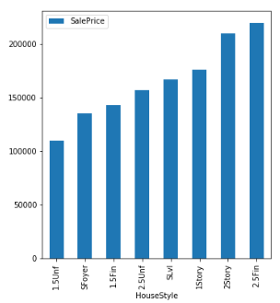
Initial findings – number of stories
Surprise: 1 story house more expensive than a one and a half story (finished or unfinished) and more expensive than a two stories house with 2nd level unfinished.
EXPLANATION:
1.5 and 2 stories houses with 2nd level unfinished are located in "poor" neighborhoods
1.5 and 2 stories houses with 2nd level unfinished are older

Slide 8
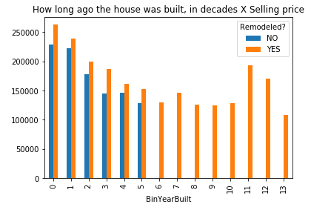
Initial findings – Remodelled x non-remodelled
Remodelled houses are more expensive than non-remodelled houses, which is the cornerstone of our project.
Another interesting fact this chart shows is that every house built more then 60 years ago have undergone a house improvement.

Slide 9
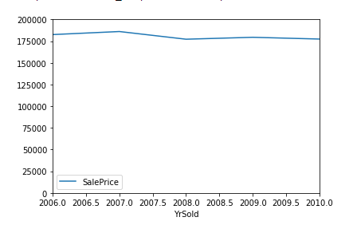
Initial findings – Inflation?
No need to take inflation into consideration

